Slide 1

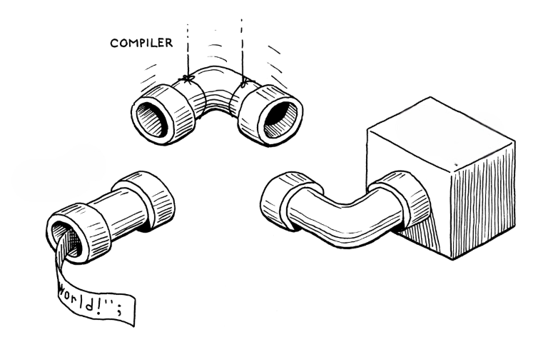
Compiler Design Project
LR(1)
LR(1) Parser Bottom Up

Slide 2
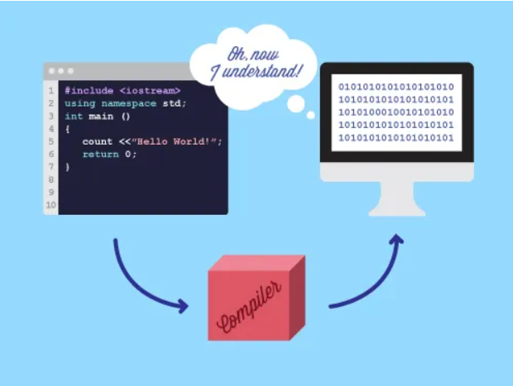
Develop a simple compiler for a C-like language.
Key Components:
01
CFG for the language .
Overview
02
Lexical Analyzer
03
LR(1) Itemsets
This Project is Intended to show the working of bottom up parser by implimenting a LR(1) Parser for a Simple C like Language
04
LR(1) Parsing Table
05
Bottom Up Parser
06
Symbol Table

Slide 3

Language Specification
Data Types: int, float, void
Input/Output: read, print
Operators: +, -, *, /, %, ++
Conditionals: if, else (no nesting)
Relational Operators: <,>,==
Multiple functions allowed
Declarations can appear anywhere with proper scope handling

Slide 4

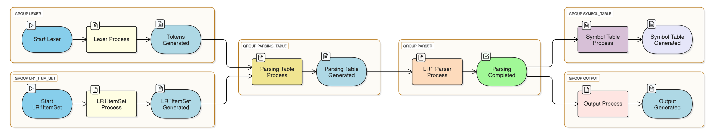
High Level Architechture

Slide 5
Context Free Grammar Design
TOKENS ID NUM DEC INT VOID FLOAT EQ LPAREN RPAREN LBRACE RBRACE SEMI COMMA IF ELSE READ PRINT EQEQ LT GT PLUS MINUS MULT DIV MOD INC
function: type_specifier ID LPAREN params RPAREN compound_stmt
;
params:
| type_specifier ID COMMA params
| type_specifier ID
;
compound_stmt: LBRACE statement_list RBRACE
;
statement_list: statement
| statement_list statement
;
statement: declaration
| assignments
| return_stmt
| condition
| read_stmt
| print_stmt
;
return_stmt: ID expression SEMI
;
assignments: ID EQ expression SEMI
;
expression: ID
| NUM
| DEC
| expression PLUS expression
| expression MINUS expression
| expression MULT expression
| expression DIV expression
| expression MOD expression
| expression INC
| LPAREN expression RPAREN
;
condition: IF LPAREN rel_expression RPAREN compound_stmt ELSE compound_stmt
;
rel_expression: expression EQEQ expression
| expression LT expression
| expression GT expression
;
read_stmt: READ ID SEMI
;
print_stmt: PRINT expression SEMI
;
S: function_list S
| declaration_list S
| function_list
| declaration_list
;
declaration_list: declaration
| declaration_list declaration
;
declaration: type_specifier ID SEMI
;
type_specifier: INT
| VOID
| FLOAT
;
function_list: function
| function_list function
;

Slide 6
CFG Explanation(Part 1)
Start Symbol: S defines a program that can consist of multiple declarations and functions.
Declaration and Function Blocks:
declaration_list represents multiple variable declarations.
function_list allows defining one or more functions.
function has structure: return type + function name + parameters + compound statement.
Parameter Parsing:
params allows functions to have typed parameters or be empty.
Compound Statement:
Block enclosed in {} that holds a list of valid statements.

Slide 7
CFG Explanation(contd..)
Statements include:
declaration, assignments, return_stmt, condition, read_stmt, print_stmt
Expressions:
Support arithmetic: +, -, *, /, %, and ++
Can include variables, numbers, or nested expressions
Conditionals:
Format: if (rel_expression) { ... } else { ... }
No nested if-else support
Relational Expressions:
Comparisons using ==, <, and >
I/O Statements:
read_stmt and print_stmt use READ and PRINT tokens respectively

Slide 8
Lexical Analyzer Overview (Part II)
Key Features of This Lexer:
Input: Takes a C-like source code file as input.
Token Recognition:
Recognizes keywords (int, float, void, etc.)
Identifiers (x, sum, etc.)
Numbers (123, 45.67)
Operators (+, -, ==, ++, etc.)
Punctuation (;, ,, (), {}, etc.)
Regex-Based Matching:
Uses Regular Expressions to identify different token types.
Error Handling:
Detects lexical errors (invalid characters).
Line & Scope Tracking:
Tracks line number, position, and level for each token.
Purpose:
Acts as a scanner to break down raw source code into a clean stream of tokens for the parser.
Helps simplify syntax analysis by filtering out whitespaces and comments.

Slide 9
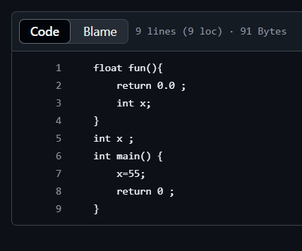
Sample Input Program
Reference: program.txt
Small program with variables, functions, I/O, and condition
Highlight parts for grammar, lexer, parser

Slide 10
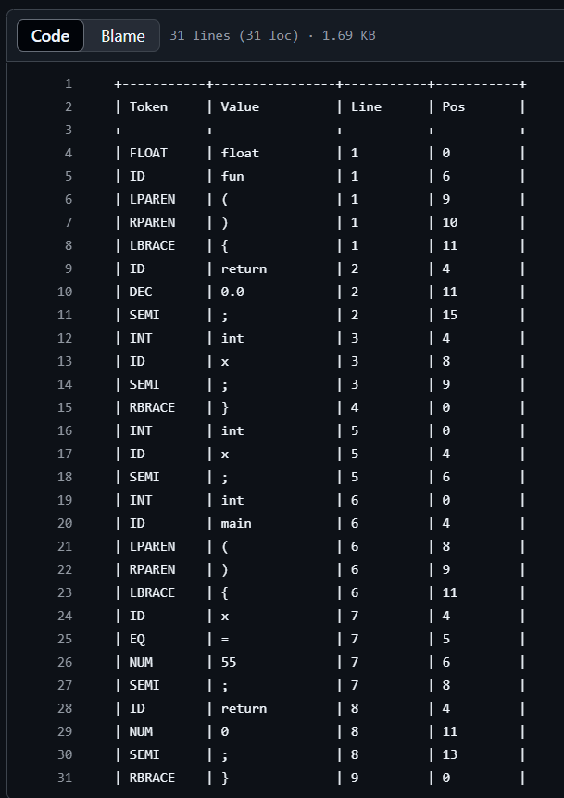
Token Generated:
Structure of tokens.txt:
The file presents tokenized output in a tabular format with the following columns:​
Token: The type of the token identified (e.g., FLOAT, ID, LPAREN).​
Value: The actual string from the source code that corresponds to the token.​
Line: The line number in the source code where the token appears.​
Pos: The position within the line where the token starts.

Slide 11
Symbol Table Overview(Part-III):
Key Features of symbolTable.cpp:
Symbol Structure: Defines a Symbol structure to encapsulate attributes of each identifier, including:​
tokenType
name
value
line:
pos
scope
memoryAddress:
Operations: Provides functionalities to:​
Insert: Add new identifiers into the symbol table with their respective attributes.​
Lookup: Search for existing identifiers to retrieve their information.​
Update: Modify attributes of existing identifiers, such as updating their usage status or assigned value.​
Display: Output the contents of the symbol table, typically in a tabular format, for debugging or analysis purposes.

Slide 12
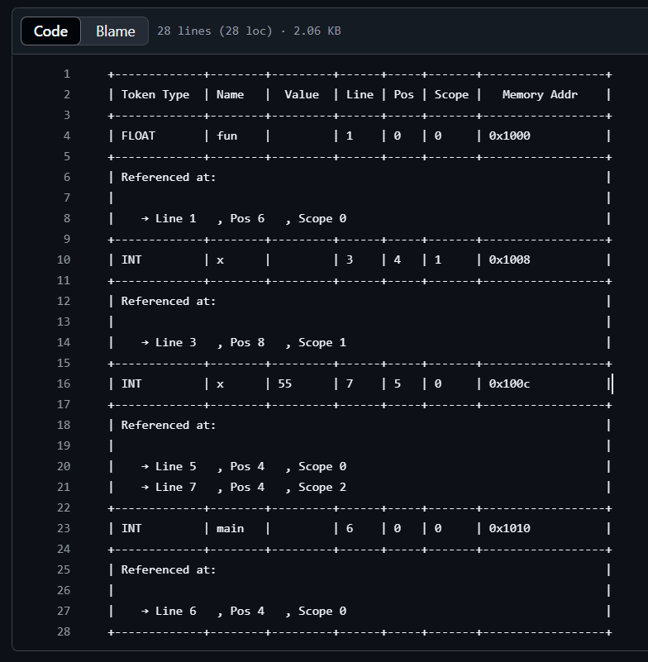
Symbol Table Output:
Read the stream of tokens from the token.txt
Maintains the Scope of variable
Created During the parsing phase

Slide 13
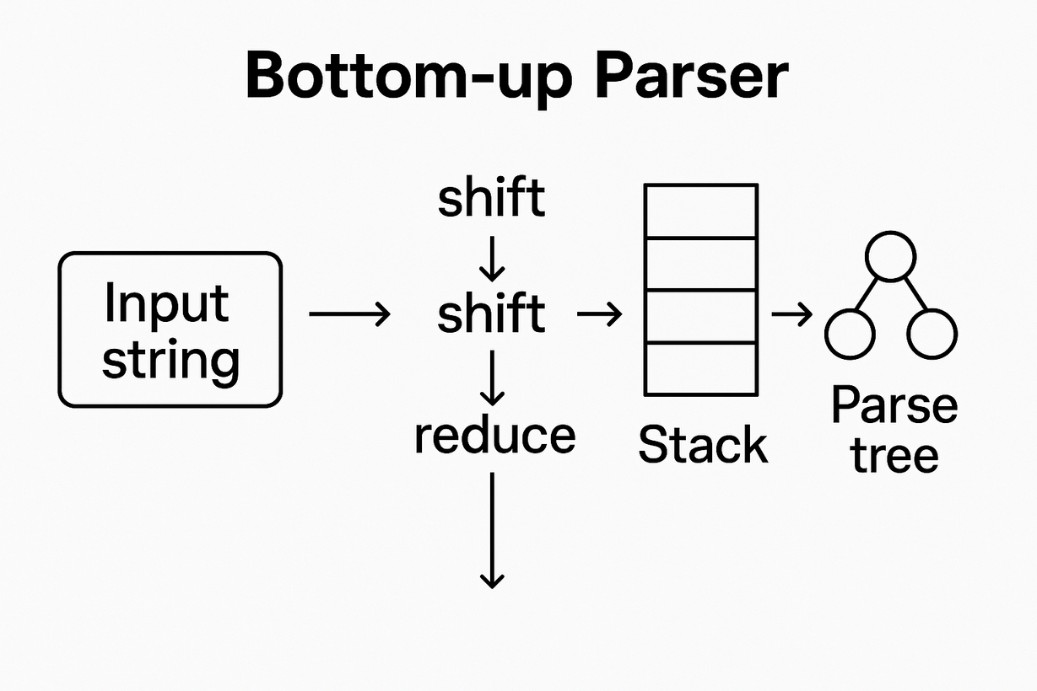
Bottom Up ParserOverview(Part-IV):
Reference: lr1parser.cpp
Strategy: LR(1) Parsing
Modules:
Item Set Construction
Parsing Table
Input Parsing

Slide 14
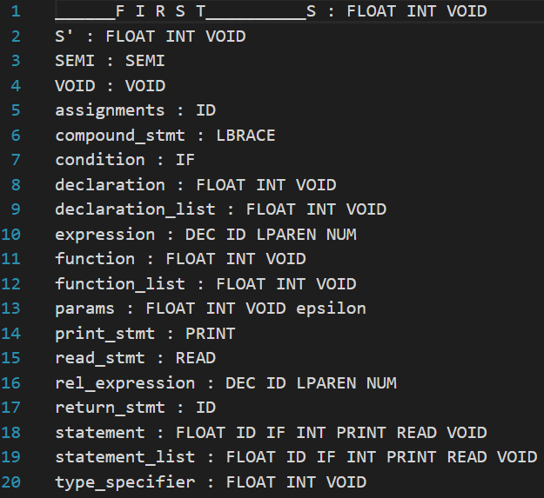
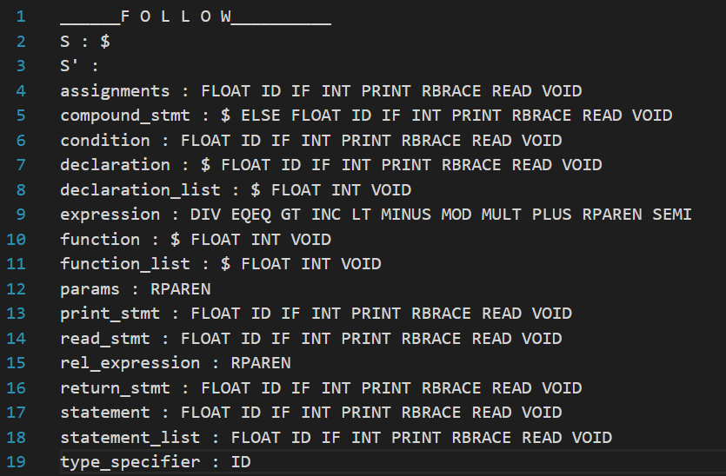
LR(1) Itemset Construction
Reference: lr1itemsetscpp
Strategy: finding first and follow

Slide 15
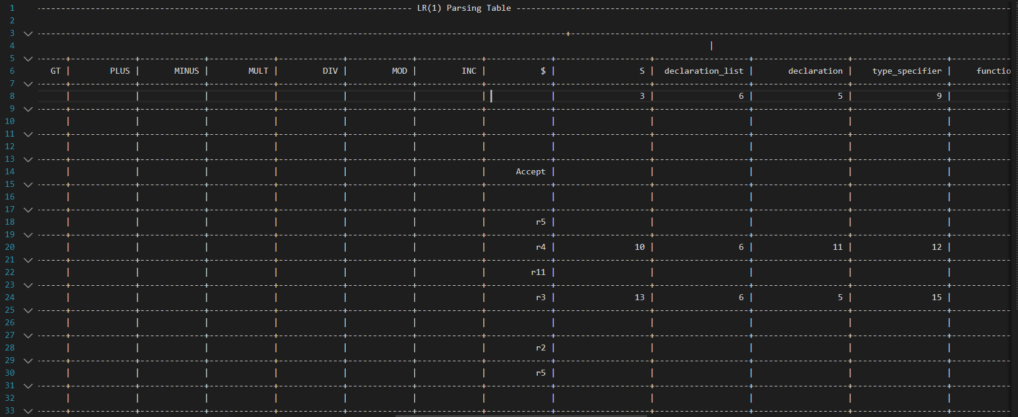
PARSING TABLE

Slide 16
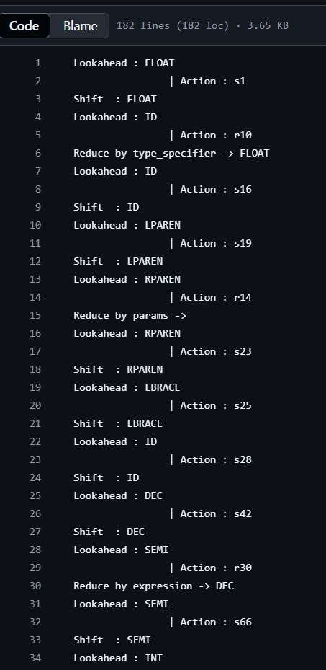
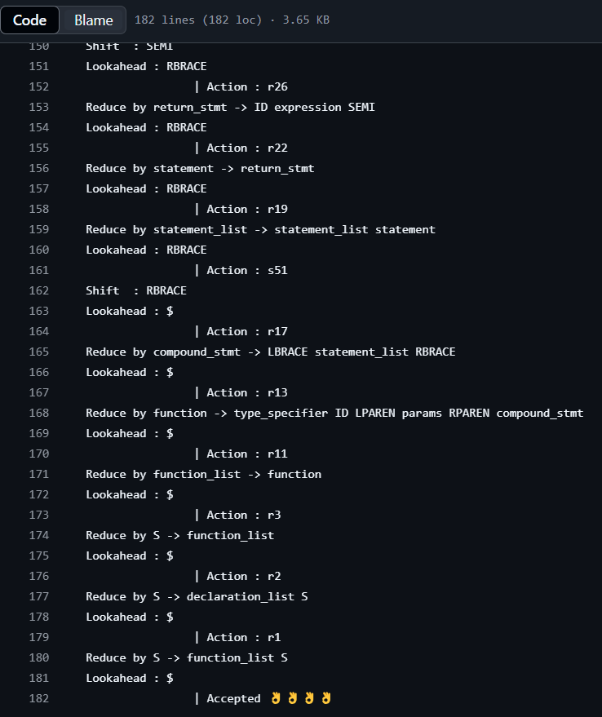
Parsing The Input Program

Slide 17
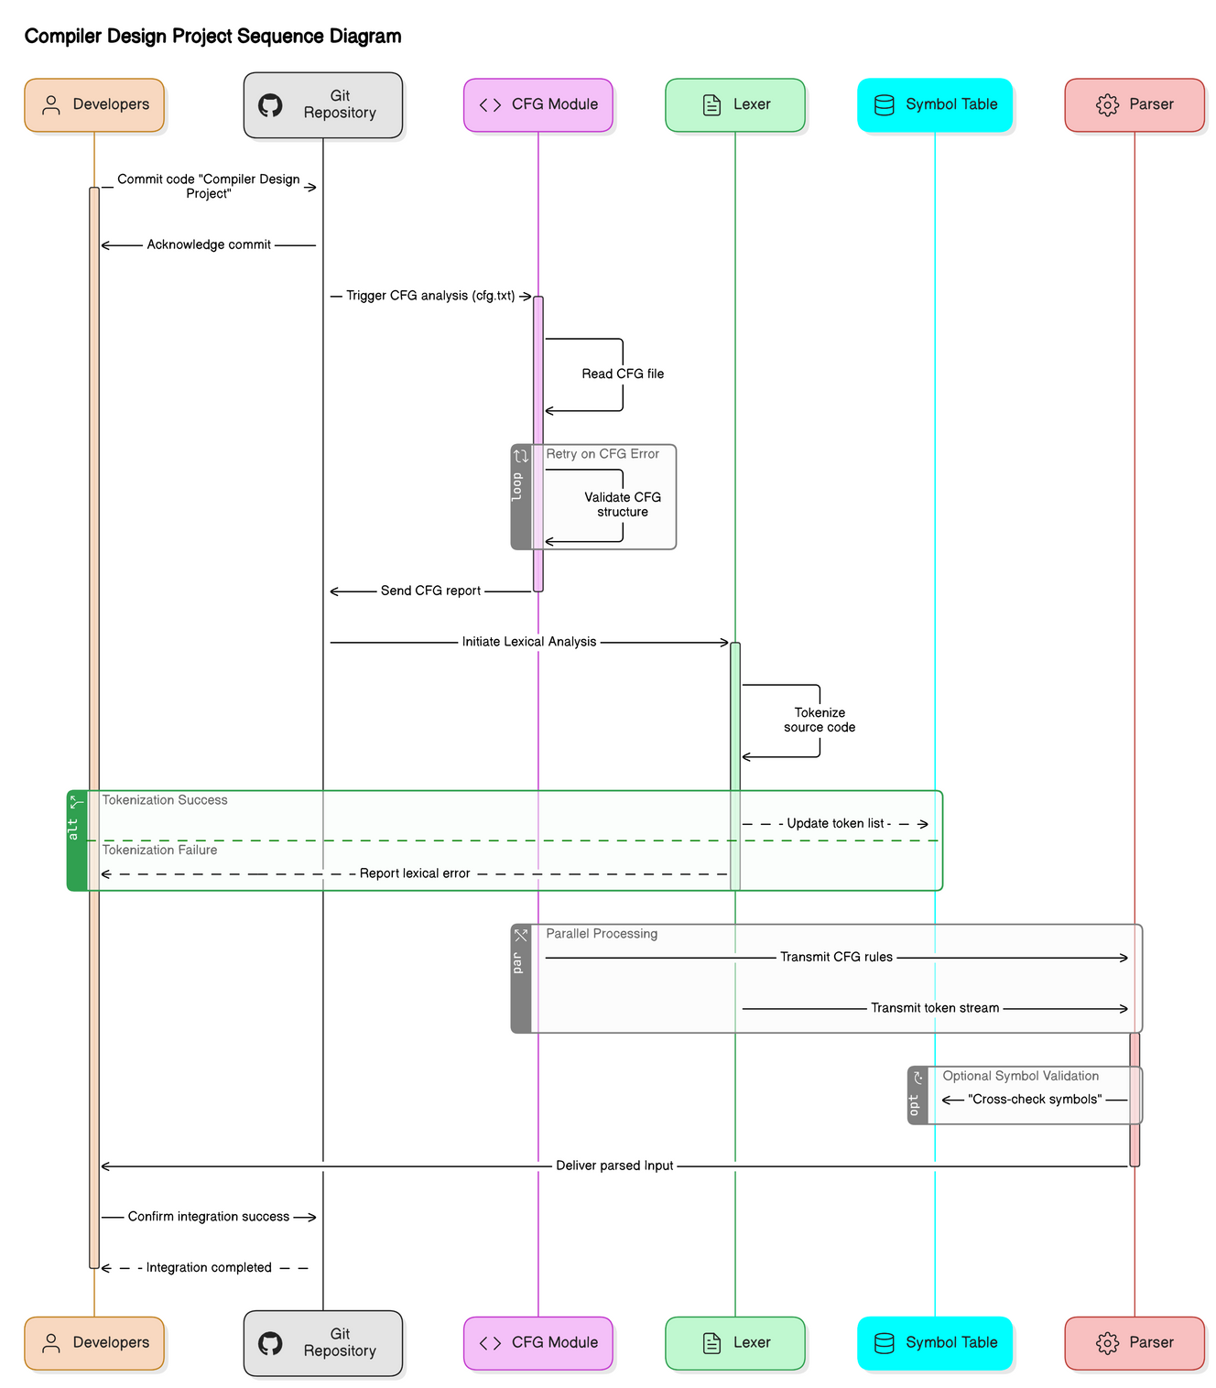

Slide 18
Conclusion & Future Work:
Conclusion:
Successfully built a basic compiler pipeline for a simple C-like language.
Implemented context-free grammar, lexical analysis, parsing, and symbol table management.
Demonstrated parsing using LR(1) with a working parser and tokenized output.
Future Work:
Support for nested conditionals and complex block structures.
Integration of type checking and error handling mechanisms.
Intermediate code generation and optimization.
GUI-based input and output interface for user-friendliness.

Slide 19
Thank you
Presented By:-
Abhinandan Barua (002210501002)
Shahir Habib(002210501006)
Masud ALam Mondal(002210501007)
Sanket Chakraborty(002210501130)

